Slide 1
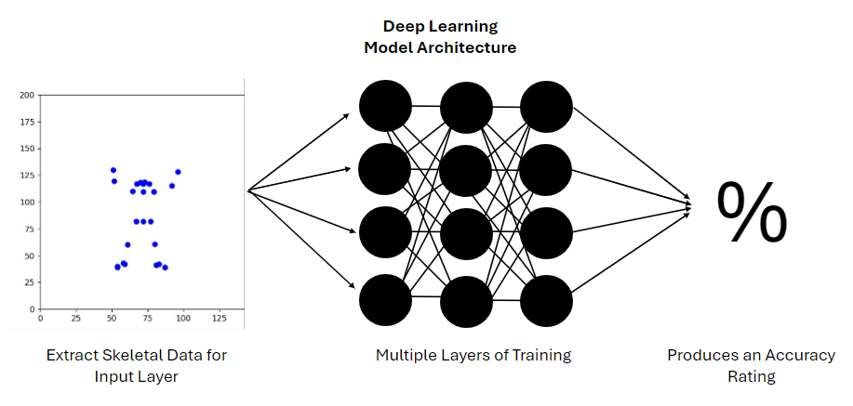
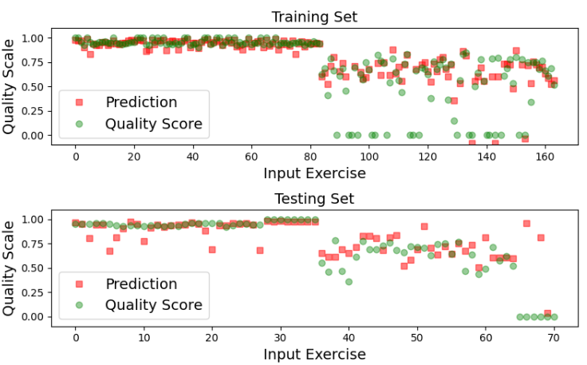
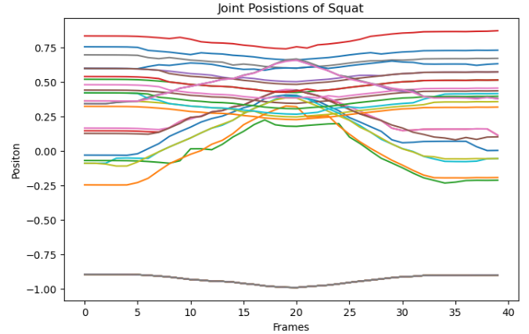
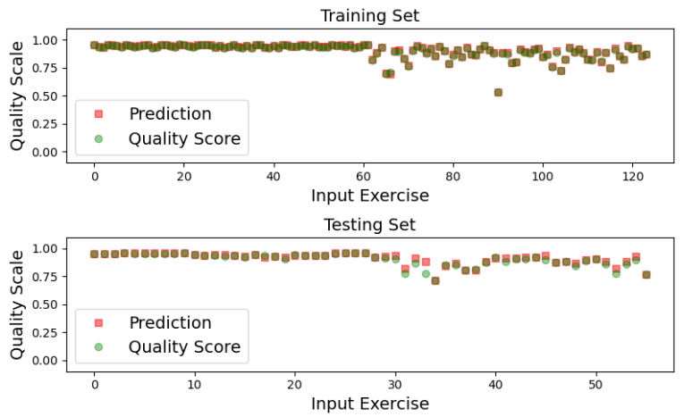
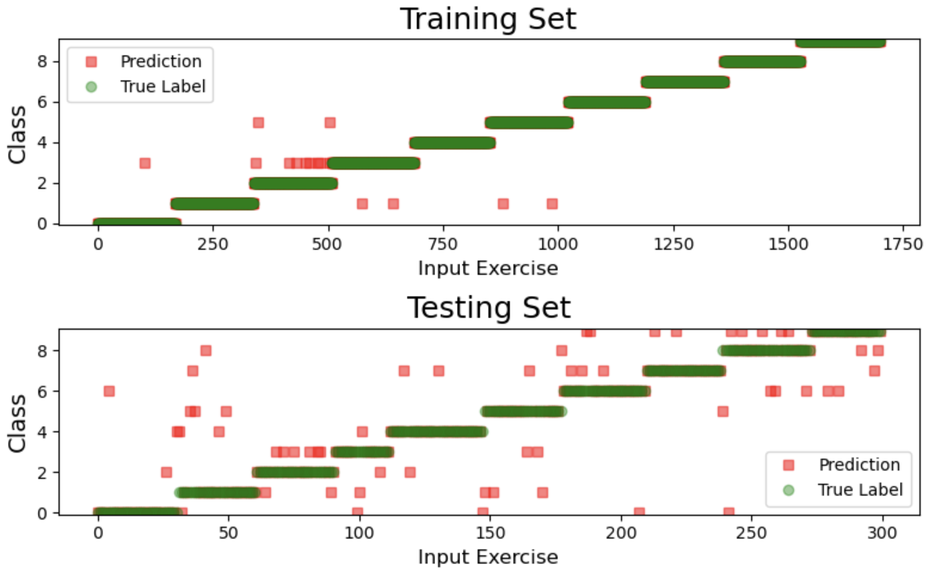


Using Deep Learning to Provide Feedback for Remote Physical Rehabilitation
Team: Xian Gao, Molly Meadows, Noah Rieth
Objective
Concept Development
Validation
Train machine learning models to produce feedback for videos of physical therapy exercises taken with a smart phone.
Background
A Deep Learning Framework for Assessing Physical Rehabilitation Exercises (Vakanski et al.)
OpenPose (Body_25 Model)
Skeletal extraction convolutional network model
Python, Matlab, Jupyter Notebook
Final design
Value Proposition
Validation of the spatio-temporal model using OpenPose data.
Recovery time after injury can be extended when:
Exercises are performed ineffectively
Patients are discouraged from performing exercises due to lack of clear instruction
Physical therapy sessions can be expensive
Provide feedback for the quality of an exercise, given a smart phone recorded video
Visual representation of a single deep squat used as input. Each line represents the x or y position of a joint over time.
Key requirements
Analyze a video taken by a smart phone
Model must be trained on at least one exercise
Produce a numerical accuracy rating
Provide feedback in a reasonable amount of time
Extract movement data from joint positions
Validation of the spatio-temporal model using Vicon data.
Conclusion
Use a larger database of self-recorded videos for extensive model training and better generalization​
Explore alternative methods of extracting skeletal data
Acknowledgements
Sponsor: University of Idaho Computer Science Department (MIDA Lab)
Clients: Dr. Aleksandar Vakanski, Dr. Min Xian
Instructor: Bruce Bolden
Performance of a recurrent neural network that classifies input as one of 10 selected exercises like squat, lunge, hurdle step, etc.

